Slide 1



CLOUD AND EDGE COMPUTING
Noida Institute of Engineering and Technology, Greater Noida
Noida Institute of Engineering and Technology, Greater Noida
Unit:1
Introduction
Jaya Nidhi Vashishtha
Assistant Professor, CSE-IOT
NIET, Greater Noida
B Tech 6th Sem
1

Slide 2
Evaluation Scheme
Sl. No. | Subject Codes | Subject Name | Periods |  |  | Evaluation Scheme |  |  |  | End Semester |  | Total | Credit
 |  |  | L | T | P | CT | TA | TOTAL | PS | TE | PE
1 | ACSML0601 | Machine Learning | 3 | 0 | 0 | 30 | 20 | 50 |  | 100 |  | 150 | 3
2 | ACSIOT0601 | IoT Protocols & Its Applications | 3 | 1 | 0 | 30 | 20 | 50 |  | 100 |  | 150 | 4
3 | ACSIOT0602 | Cloud and Edge Computing | 3 | 0 | 0 | 30 | 20 | 50 |  | 100 |  | 150 | 3
4 |  | Departmental Elective-III | 3 | 0 | 0 | 30 | 20 | 50 |  | 100 |  | 150 | 3
5 |  | Departmental Elective-IV | 3 | 0 | 0 | 30 | 20 | 50 |  | 100 |  | 150 | 3
6 |  | Open Elective-I | 3 | 0 | 0 | 30 | 20 | 50 |  | 100 |  | 150 | 3
7 | ACSML0651 | Machine Learning Lab | 0 | 0 | 2 |  |  |  | 25 |  | 25 | 50 | 1
8 | ACSIOT0651 | IOT Lab using Raspberry PI Lab | 0 | 0 | 2 |  |  |  | 25 |  | 25 | 50 | 1
9 | ACSIOT0652 | Cloud and Edge Computing Lab | 0 | 0 | 2 |  |  |  | 25 |  | 25 | 50 | 1
10 | ACSE0659 | Mini Project | 0 | 0 | 2 |  |  |  | 50 |  |  | 50 | 1
11 | ANC0602 / ANC0601 | Essence of Indian Traditional Knowledge / Constitution of India, Law and Engineering | 2 | 0 | 0 | 30 | 20 | 50 |  | 50 |  | 100
12 |  | MOOCs (For B.Tech. Hons. Degree)
 |  | GRAND TOTAL |  |  |  |  |  |  |  |  |  | 1100 | 23
Jaya Nidhi Vashishtha
ACSIOT0602
Unit1
2

Slide 3
Syllabus
Course Contents / Syllabus
UNIT-I | Introduction | 8 HOURS
Introduction to Cloud Computing – Definition of Cloud – Evolution of Cloud Computing – Underlying Principles of Parallel and Distributed Computing – Cloud Characteristics – Elasticity in Cloud – On-demand Provisioning, EC2 Instances and its types. Overview of different cloud service providers
UNIT-II | Cloud Enabling Technologies: | 8 HOURS
Service Oriented Architecture – REST and Systems of Systems – Web Services – Publish Subscribe Model – Basics of Virtualization – Types of Virtualization – Implementation Levels of Virtualization – Virtualization Structures – Tools and Mechanisms – Virtualization of CPU – Memory – I/O Devices –Virtualization Support and Disaster Recovery.
UNIT-III | Cloud Architecture, Services and Storage: | 8 HOURS
Layered Cloud Architecture Design – NIST Cloud Computing Reference Architecture – Public, Private and Hybrid Clouds – laaS – PaaS – SaaS – Architectural Design Challenges – Cloud Storage – Storage-as-a-Service – Advantages of Cloud Storage – Cloud Storage Providers – S3, RDS, EBS.
Jaya Nidhi Vashishtha
ACSIOT0602
Unit1
3

Slide 4
Syllabus
UNIT-IV | Edge Computing | 8 HOURS
Introduction of edge computing, Difference between client server model and edge computing, components of edge computing, Edge Testbed: edge environment, launching an edge testbed, launching an edge application, Building an edge application; Agent based systems, Secret agent communications.
UNIT-V | OTA & IoT Agent | 8 HOURS
OTA introduction, Terminology, Design Considerations, OTA example, Porting the OTA Library. IoT agent: overview, Agent Console, Comparison between Edge and Fog computing. Streaming complex event processing: Streaming data, complex event processing, and complex event processing in edge computing.
Jaya Nidhi Vashishtha
ACSIOT0602
Unit1

Slide 5
Branch wise Application
To create high visibility, IoT and cloud solutions should connect and allow communication between things, people, and processes, computing.
Cloud computing helps in storing and analyzing this data to provide the maximum benefits of an IoT infrastructure.
IoT is just not limited to functions of data gathering, systems connectivity, storage, and analytics.
It also helps in the modernization of operations by connecting legacy & smart devices, and machines to the internet, and reducing the barriers between IT and OT teams with a unified view of the systems and data.
With cloud computing, organizations do not have to deploy extensive hardware or configure and manage networks & infrastructure in IoT deployments.
Cloud computing also enables enterprises to scale up their infrastructure, depending on their needs, without setting up additional hardware and infrastructure.
Jaya Nidhi Vashishtha
ACSIOT0602
Unit1

Slide 6
Course Objective
The primary objective of this course is to introduce students to the foundations of computability theory. The other objectives include:
Introduce concepts of Cloud Computing, Evolution of cloud Computing, Cloud Characteristics, Elasticity in cloud, and overview of different cloud services.
Identify service oriented architecture and rest of the systems , Web services,
Publish and subscribe model and basics of virtualization.
Understand various edge computing concepts like client server model. Components of edge computing and test bed edge environment and cloud computing concepts in IOT.
Jaya Nidhi Vashishtha
ACSIOT0602
Unit1

Slide 7
Course Outcomes
Course outcomes : After completion of this course students will be able to
CO 1 | Understand Cloud Computing and different deployment models. | K1
CO 2 | Describe importance of virtualization along with their technologies. | K2
CO 3 | Apply different cloud computing services. | K3
CO 4 | Build an Edge application. | K6
CO5 | Manage IoT for Edge computing. | K4
Jaya Nidhi Vashishtha
ACSIOT0602
Unit1
7

Slide 8

Program Specific Outcomes
Our graduates will be able to
Apply concept of IoT to solve real world problems for societal wellbeing by leveraging latest tools.
Work as an individual or lead as a team with good communication and engage in life-long learning.
Apply ethical principles as a successful professional, entrepreneur, and pursue higher education.
Jaya Nidhi Vashishtha
ACSIOT0602
Unit1
8

Slide 9
CO-PO and PSO Mapping
 | PO1 | PO2 | PO3 | PO4 | PO5 | PO6 | PO7 | PO8 | PO9 | PO10 | PO11 | PO12
CO1 | 2 | 2 | 3 | 3 | 2 | 2 | - | - | 2 | 1 | - | 3
CO2 | 1 | 3 | 2 | 3 | 2 | 2 | - | 1 | 1 | 1 | 2 | 2
CO3 | 2 | 2 | 3 | 2 | 2 | 2 | - | 2 | 2 | 1 | 2 | 3
CO4 | 2 | 2 | 2 | 3 | 2 | 2 | - | 2 | 2 | 1 | 1 | 3
CO5 | 3 | 2 | 2 | 2 | 2 | 2 | - | 2 | 1 | 1 | 1 | 2
Average | 2 | 2.2 | 2.4 | 2.6 | 2 | 2 | - | 1.4 | 1.6 | 1 | 1.2 | 2.6
Jaya Nidhi Vashishtha
ACSIOT0602
Unit1
9

Slide 10
Program Educational Objectives(PEOs)
Our graduates will be able to
Engage in designing, manufacturing/fabricating, and maintaining smart systems in the field of IoT.
Solve problems of social relevance through applying the knowledge of basic science, IoT and pursue higher education and research.
Engage in life-long learning, career enhancement, and be able to adapt to dynamic needs of profession and society.
Work as an individual and as a team member in multidisciplinary projects with effective communication.
Jaya Nidhi Vashishtha
ACSIOT0602
Unit1
10

Slide 11

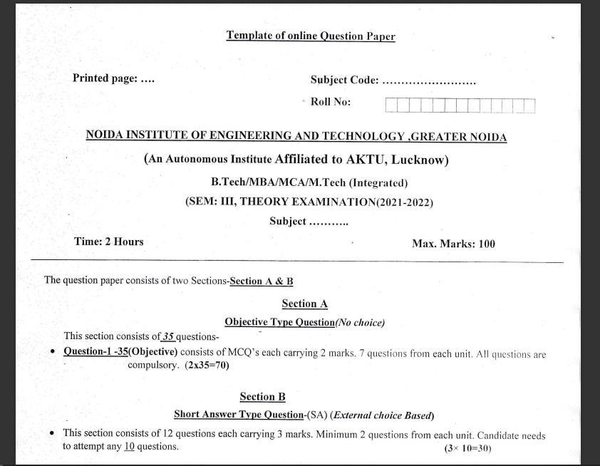
End Semester Question Paper Templates
Jaya Nidhi Vashishtha
ACSIOT0602
Unit1
11

Slide 12
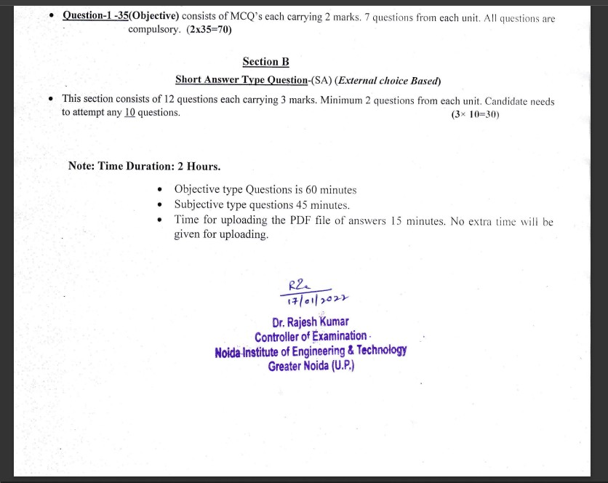
End Semester Question Paper Templates
Jaya Nidhi Vashishtha
ACSIOT0602
Unit1
12

Slide 13
Prerequisites
The student should have knowledge of:
Basics of OS.
Basic concepts of computer fundamentals of computer system and cloud and edge computing
Jaya Nidhi Vashishtha
ACSIOT0602
Unit1

Slide 14

Brief Introduction of Subject
Cloud and edge computing have a variety of cloud computing platforms allow enterprises to supplement their private data centers with global servers that extend their infrastructure to any location and allow them to scale computational resources up and down as needed.
These hybrid public-private clouds offer unprecedented flexibility, value and security for enterprise computing applications benefits and use cases, and can work together.
Cloud services can react and adapt to changing demands instantly by automatically provisioning and deprovisioning resources. This can lower costs and increase the overall efficiency of organizations.
Data backup, disaster recovery and business continuity are easier and less expensive because data can be mirrored at multiple redundant sites on the cloud provider’s network.
Jaya Nidhi Vashishtha
ACSIOT0602
Unit1

Slide 15
Unit Objective
To study Introduction to Cloud Computing
To study the basic concepts about Underlying Principles of Parallel and Distributed Computing.
Understanding the Elasticity in Cloud
Understanding of EC2 Instances and its types
Overview of different cloud service providers
Jaya Nidhi Vashishtha
ACSIOT0602
Unit1

Slide 16

Unit Contents
Introduction to Cloud Computing
Definition of Cloud
Evolution of Cloud Computing
Underlying Principles of Parallel and Distributed Computing
Cloud Characteristics
Elasticity in Cloud
On-demand Provisioning,
EC2 Instances and its types.
Overview of different cloud service providers
Jaya Nidhi Vashishtha
ACSIOT0602
Unit1

Slide 17

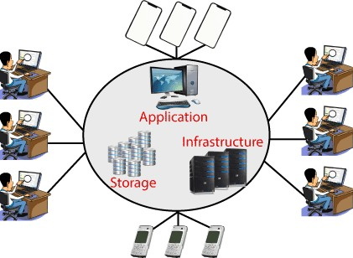
Introduction to Cloud Computing
Cloud Computing is the delivery of computing services such as servers, storage, databases, networking, software, analytics, intelligence, and more, over the Cloud (Internet).
Fig1: Cloud Demonstration
Jaya Nidhi Vashishtha
ACSIOT0602
Unit1

Slide 18
Introduction to Cloud Computing
Cloud Computing provides an alternative to the on-premises data centre.
With an on-premises data centre, we have to manage everything, such as purchasing and installing hardware, virtualization, installing the operating system, and any other required applications, setting up the network, configuring the firewall, and setting up storage for data.
After doing all the set-up, we become responsible for maintaining it through its entire lifecycle.
If we choose Cloud Computing, a cloud vendor is responsible for the hardware purchase and maintenance.
They also provide a wide variety of software and platform as a service. We can take any required services on rent.
The cloud computing services will be charged based on usage.
Jaya Nidhi Vashishtha
ACSIOT0602
Unit1

Slide 19
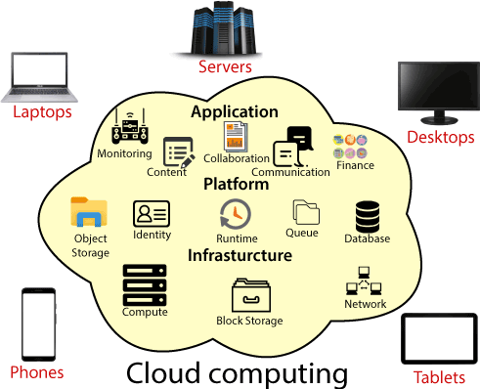
Introduction to Cloud Computing
Fig2: Cloud Computing
Jaya Nidhi Vashishtha
ACSIOT0602
Unit1

Slide 20
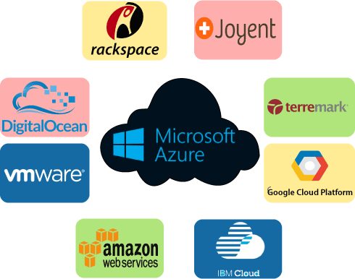
Introduction to Cloud Computing
The cloud environment provides an easily accessible online portal that makes handy for the user to manage the compute, storage, network, and application resources. Some cloud service providers are in the following figure.
Fig3: Example of cloud service provider
Jaya Nidhi Vashishtha
ACSIOT0602
Unit1

Slide 21

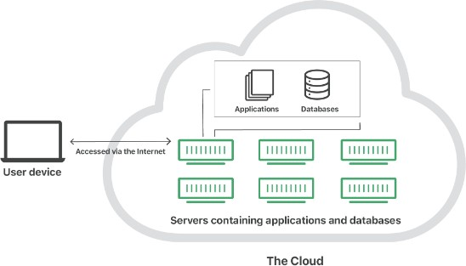
Definition of Cloud
As per NIST(National Institute of Standards and Technology)
Cloud computing is a model for enabling ubiquitous, convenient, on-demand network access to a shared pool of configurable computing resources (e.g., networks, servers, storage, applications, and services) that can be rapidly provisioned and released with minimal management effort or service provider interaction.
The term Cloud refers to a Network or Internet. In other words, we can say that Cloud is something, which is present at remote location.
Cloud can provide services over public and private networks, i.e.,
WAN, LAN or VPN.
Applications such as e-mail, web conferencing, customer relationship management (CRM) execute on cloud.
Fig4: Cloud
Jaya Nidhi Vashishtha
ACSIOT0602
Unit1

Slide 22
Definition of Cloud
"The cloud" refers to servers that are accessed over the Internet, and the software and databases that run on those servers.
Cloud servers are located in data centers all over the world. By using cloud computing, users and companies do not have to manage physical servers themselves or run software applications on their own machines.
The cloud enables users to access the same files and applications from almost any device, because the
computing and storage takes place on servers in a data center, instead of locally on the user device.
This is why a user can log in to their Instagram account on a new phone after their old phone breaks and still find their old account in place, with all their photos, videos, and conversation history.
It works the same way with cloud email providers like Gmail or Microsoft Office 365, and with cloud storage providers like Dropbox or Google Drive.
Jaya Nidhi Vashishtha
ACSIOT0602
Unit1

Slide 23
Recap
Introduction to cloud computing
Definition of cloud
Jaya Nidhi Vashishtha
ACSIOT0602
Unit1

Slide 24
Daily Quiz
1. What is the primary concept of cloud computing? a) Hosting physical servers in individual offices b) Providing on-demand access to shared computing resources over the internet c) Developing software specifically for local machines d) Restricting the scalability of computing resources
Answer: b) Providing on-demand access to shared computing resources over the internet
3. What are the essential characteristics of cloud computing as defined by NIST? a) Costly infrastructure, minimal resource pooling, and manual scalability b) On-demand self-service, broad network access, and resource pooling c) Restricted access, offline operations, and fixed resources d) Unregulated access, high maintenance costs, and manual operation
Answer: b) On-demand self-service, broad network access, and resource pooling
2. Which of the following best describes the "cloud" in cloud computing? a) A physical data center located on user premises b) A metaphor for the internet and shared computing resources available remotely c) A specialized software for networking applications d) A centralized program for database management
Answer: b) A metaphor for the internet and shared computing resources available remotely
4. Which deployment model of cloud computing is shared by multiple organizations with a common mission or concern? a) Private cloud b) Public cloud c) Community cloud d) Hybrid cloud
Answer: c) Community cloud
Jaya Nidhi Vashishtha
ACSIOT0602
Unit1

Slide 25

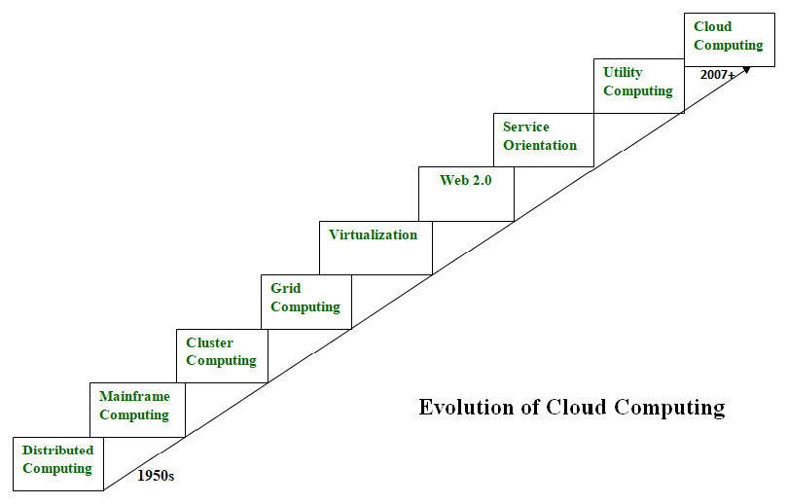
Evolution of Cloud Computing
Cloud computing is all about renting computing services.
This idea first came in the 1950s. In making cloud computing what it is today, five technologies played a vital role.
These are distributed systems and its peripherals, virtualization, web 2.0, service
orientation, and utility computing.
Fig5: Evolution of Cloud Computing
Jaya Nidhi Vashishtha
ACSIOT0602
Unit1
23

Slide 26
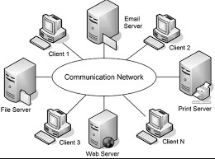
Evolution of Cloud Computing
Distributed Systems:
It is a composition of multiple independent systems but all of them are
depicted as a single entity to the users.
The purpose of distributed systems is to share resources and also use them effectively and efficiently.
Distributed systems possess characteristics such as scalability, concurrency,
continuous availability, heterogeneity, and independence in failures.
But the main problem with this system was that all the systems were required to be present at the same geographical location.
Fig6: Distributed System
Jaya Nidhi Vashishtha
ACSIOT0602
Unit1
24

Slide 27
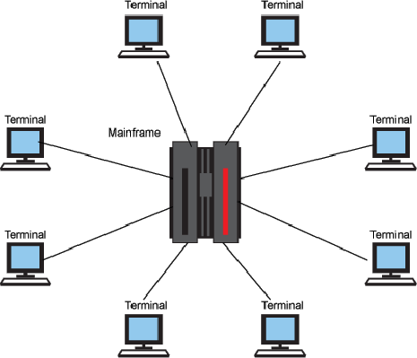
Evolution of Cloud Computing
Mainframe computing:
Mainframes which first came into existence in 1951 are highly powerful and reliable computing machines.
These are responsible for handling large data such as massive input-out put operations.
Even today these are used for bulk processing tasks such as online transactions etc.
These systems have almost no
downtime with high fault tolerance.
Fig7: Mainframe Computing
Jaya Nidhi Vashishtha
ACSIOT0602
Unit1
25

Slide 28
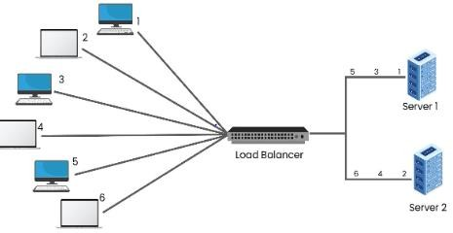
Evolution of Cloud Computing
Cluster computing:
In 1980s, cluster computing came as an alternative to mainframe computing.
Each machine in the cluster was connected to each other by a network with high bandwidth.
These were way cheaper than those mainframe systems. These were equally capable of high computations. Also, new nodes could easily be added to the cluster if it was required.
Thus, the problem of the cost was solved to some extent but the problem related to geographical restrictions still pertained. To solve this, the concept of grid computing was introduced.
Fig8: Cluster Computing
Jaya Nidhi Vashishtha
ACSIOT0602
Unit1

Slide 29
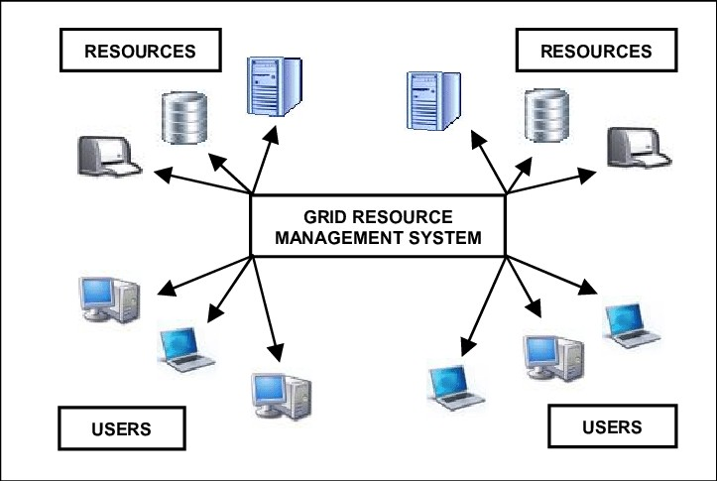
Evolution of Cloud Computing
Grid computing:
In 1990s, the concept of grid computing was introduced. It means that different systems were placed at entirely different geographical locations and these all were connected via the internet.
These systems belonged to different organizations and thus the grid consisted of heterogeneous nodes.
Although it solved some problems but new problems emerged as the distance between the nodes increased.
Fig 9: Grid Computing
Jaya Nidhi Vashishtha
ACSIOT0602
Unit1

Slide 30
Evolution of Cloud Computing
Virtualization:
It was introduced nearly 40 years back. It refers to the process of creating a virtual layer over the
hardware which allows the user to run multiple instances simultaneously on the hardware.
It is a key technology used in cloud computing.
It is the based on which major cloud computing services such as Amazon EC2, VMware vCloud, etc work on.
Hardware virtualization is still one of the most common types of virtualization.
Jaya Nidhi Vashishtha
ACSIOT0602
Unit1

Slide 31
Evolution of Cloud Computing
Web 2.0:
It is the interface through which the cloud computing services interact with the clients.
It is because of Web 2.0 that we have interactive and dynamic web pages. It also increases flexibility among web pages.
Popular examples of web 2.0 include Google Maps, Facebook, Twitter, etc. Needless to say, social media is possible because of this technology only. In gained major popularity in 2004.
Jaya Nidhi Vashishtha
ACSIOT0602
Unit1

Slide 32
Evolution of Cloud Computing
Service orientation:
It acts as a reference model for cloud computing. It supports low-cost, flexible, and evolvable applications.
Two important concepts were introduced in this computing model. These were Quality of Service (QoS) which also includes the SLA (Service Level Agreement) and Software as a Service (SaaS).
Utility computing:
It is a computing model that defines service provisioning techniques for services such as compute services along with other major services such as storage, infrastructure, etc which are provisioned on a pay-per-use basis.
Thus, the above technologies contributed to the making of cloud computing.
Jaya Nidhi Vashishtha
ACSIOT0602
Unit1

Slide 33
Recap
Evolution of Cloud Computing
Jaya Nidhi Vashishtha
ACSIOT0602
Unit1

Slide 34
Daily quiz
1. Which of the following technologies significantly contributed to the evolution of cloud computing? a) Artificial Intelligence (AI) and Machine Learning (ML) b) Virtualization and distributed computing c) Local storage and floppy disks d) Analog computing and wired networks
Answer: b) Virtualization and distributed computing
3. Which company is credited with introducing the first widely known cloud computing platform in 2006? a) Google b) Amazon Web Services (AWS) c) Microsoft d) IBM
Answer: b) Amazon Web Services (AWS)
2. What was a key milestone in the evolution of cloud computing during the 1990s? a) The development of the first internet browser b) The emergence of Application Service Providers (ASPs) c) The invention of the World Wide Web d) The decline of distributed computing
Answer: b) The emergence of Application Service Providers (ASPs)
4. What role did grid computing play in the evolution of cloud computing? a) It replaced virtualization entirely. b) It introduced the idea of pooling computing resources for high-performance tasks. c) It focused exclusively on storage solutions. d) It eliminated the need for network connectivity.
Answer: b) It introduced the idea of pooling computing resources for high-performance tasks.
Jaya Nidhi Vashishtha
ACSIOT0602
Unit1

Slide 35

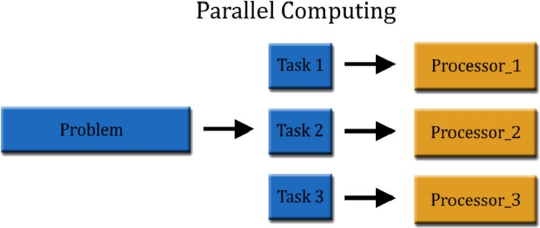
Principles of Parallel and Distributed Computing
Parallel computing refers to the process of executing several processors an application or computation simultaneously.
Generally, it is a kind of computing architecture where the large problems break into independent, smaller, usually similar parts that can be processed in one go.
It is done by multiple CPUs communicating via shared memory, which combines results upon completion. It helps in performing large computations as it divides the large problem between more than one processor.
Fig10: Parallel Computing
Jaya Nidhi Vashishtha
ACSIOT0602
Unit1
31

Slide 36
Principles of Parallel and Distributed Computing
Applications of Parallel Computing
There are various applications of Parallel Computing, which are as follows:
One of the primary applications of parallel computing is Databases and Data mining.
The real-time simulation of systems is another use of parallel computing.
The technologies, such as Networked videos and Multimedia.
Science and Engineering.
Collaborative work environments.
The concept of parallel computing is used by augmented reality, advanced graphics, and virtual reality.
Jaya Nidhi Vashishtha
ACSIOT0602
Unit1
32

Slide 37
Principles of Parallel and Distributed Computing
Advantages
It saves time and money because many resources working together cut down on time and costs.
It may be difficult to resolve larger problems on Serial Computing.
You can do many things at once using many computing resources.
Parallel computing is much better than serial computing for modeling, simulating, and comprehending complicated real-world events.
Disadvantages
The multi-core architectures consume a lot of power.
Parallel solutions are more difficult to implement, debug, and prove right due to the complexity of communication and coordination, and they frequently perform worse than their serial equivalents.
Jaya Nidhi Vashishtha
ACSIOT0602
Unit1

Slide 38
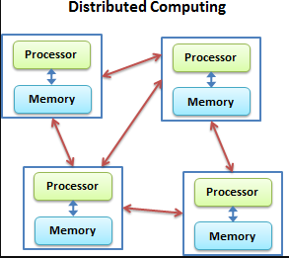
Principles of Parallel and Distributed Computing
Distributed computing is the method of making multiple computers work together to solve a common problem.
It makes a computer network appear as a powerful single computer that provides large- scale resources to deal with complex challenges
.
For example, distributed computing can encrypt large volumes of data; solve physics and chemical equations with many variables; and render high-quality, three-dimensional video animation.
Fig11: Distributed Computing
Jaya Nidhi Vashishtha
ACSIOT0602
Unit1

Slide 39
Cloud Characteristics
There are basically 5 essential characteristics of cloud computing.
On-demand self-services:
The Cloud computing services does not require any human administrators, user themselves are able to provision, monitor and manage computing resources as needed.
Broad network access:
The Computing services are generally provided over
standard networks and heterogeneous devices.
Rapid elasticity:
The Computing services should have IT resources that are able to scale out and in quickly and on as needed basis. Whenever the user require services it is provided to him and it is scale out as soon as its requirement gets over.
Resource pooling:
The IT resource (e.g., networks, servers, storage, applications, and services) present are shared across multiple applications and occupant in an uncommitted manner.
Multiple clients are provided service from a
same physical resource.
Measured service:
The resource utilization is tracked for each application and occupant, it will provide both the user and the resource provider with an account of what has been used.
This is done for various reasons like monitoring billing and effective use of resource.
Jaya Nidhi Vashishtha
ACSIOT0602
Unit1

Slide 40

Recap
Underlying Principles of Parallel and Distributed Computing
Cloud Characteristics
Jaya Nidhi Vashishtha
ACSIOT0602
Unit1
38

Slide 41
Daily Quiz
1. What is the main goal of parallel computing? a) To reduce hardware costs by using a single processor b) To perform multiple calculations simultaneously to speed up processing c) To focus exclusively on I/O operations d) To replace distributed computing entirely
Answer: b) To perform multiple calculations simultaneously to speed up processing
3. What is the meaning of resource pooling in cloud computing? a) Dedicated hardware for each individual user b) Multiple customers sharing the same physical resources dynamically assigned based on demand c) Assigning fixed resources to each virtual machine d) Centralizing all data storage on local devices
Answer: b) Multiple customers sharing the same physical resources dynamically assigned based on demand
2. Which of the following is NOT a characteristic of cloud computing? a) On-demand self-service b) Unlimited scalability without any cost c) Broad network access d) Resource pooling
Answer: b) Unlimited scalability without any cost
4. In distributed computing, what is a key characteristic of the systems involved? a) All systems share the same physical memory. b) The systems operate independently but communicate to achieve a common goal. c) Only a single system executes tasks at a time. d) Tasks are strictly limited to a single physical location.
Answer: b) The systems operate independently but communicate to achieve a common goal.
Jaya Nidhi Vashishtha
ACSIOT0602
Unit1
38

Slide 42
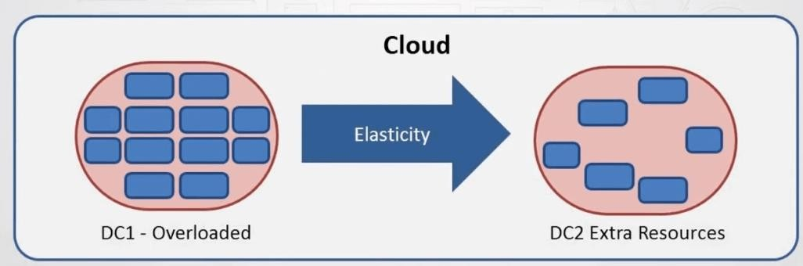
Elasticity in Cloud
Cloud Elasticity is the property of a cloud to grow or shrink capacity for CPU, memory, and storage resources to adapt to the changing demands of an organization.
Cloud Elasticity can be automatic, without need to perform capacity planning in advance of the occasion, or it can be a manual process where the organization is notified they are running low on resources and can then decide to add or reduce capacity when needed.
Fig12: Cloud Elasticity
Jaya Nidhi Vashishtha
ACSIOT0602
Unit1
36

Slide 43
Elasticity in Cloud
Cloud Elasticity is often associated with horizontal scaling (scale-out) architecture, and it generally associated with public cloud provider resources that are billed on a pay-as-you-go basis.
This approach brings real-time cloud expenditures more closely in alignment with the actual consumption of cloud services, for example when virtual machines (VMs) are spun up or down as demand for a particular application or service varies over time.
Cloud Elasticity provides businesses and IT organizations the ability to meet any unexpected jump in
demand, without the need to maintain standby equipment to handle that demand.
An organization that normally runs certain processes on-premises can ‘cloudburst’ to take advantage of Cloud Elasticity and meet that demand, returning to on-premises operations only when the demand has passed. Thus, the result of cloud elasticity is savings in infrastructure costs, in human capital, and in overall IT costs.
Jaya Nidhi Vashishtha
ACSIOT0602
Unit1
37

Slide 44
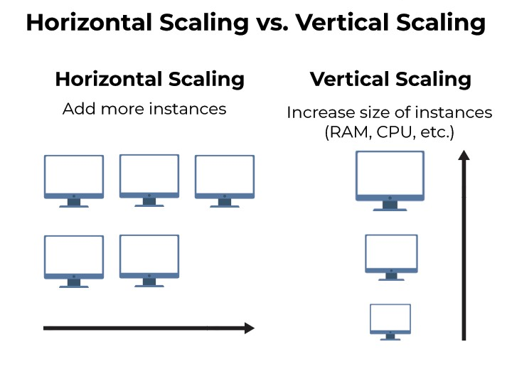
Elasticity in Cloud
Jaya Nidhi Vashishtha
ACSIOT0602
Unit1
37

Slide 45
Elasticity in Cloud
Benefits of elasticity in cloud:
Easy scalability. With on-demand computing resources, IT teams can quickly provision the exact services
and infrastructure they need to support the business.
Reduced costs. Enterprises can reduce IT budgets by paying only for the resources they consume, and by avoiding the need for capital investments in IT infrastructure.
Greater redundancy. With easy access to off-site computing resources, IT teams can take advantage of
more flexible, reliable and affordable backup and recovery solutions.
More capacity. Elastic cloud storage services provide virtually unlimited storage capacity.
High availability. With the ability to add resources and redundancy as needed, it’s easy to avoid unnecessary slowdowns or service interruptions.
Easier management. With cloud services, IT teams no longer need to worry about deploying, maintaining
and upgrading individual pieces of IT infrastructure.
Jaya Nidhi Vashishtha
ACSIOT0602
Unit1
38

Slide 46
On-demand Provisioning
On demand Provisioning
On-demand computing (ODC) is a delivery model in which computing resources are made available to the user as needed. The resources may be maintained within the user's enterprise or made available by a cloud service provider.
The term cloud computing is often used as a synonym for on-demand computing when the services are provided by a third party -- such as a cloud hosting organization.
The on-demand business computing model was developed to overcome the challenge of enterprises meeting fluctuating demands efficiently.
Because an enterprise's demand for computing resources can be unpredictable at
times, maintaining sufficient resources to meet peak requirements can be costly.
Jaya Nidhi Vashishtha
ACSIOT0602
Unit1

Slide 47

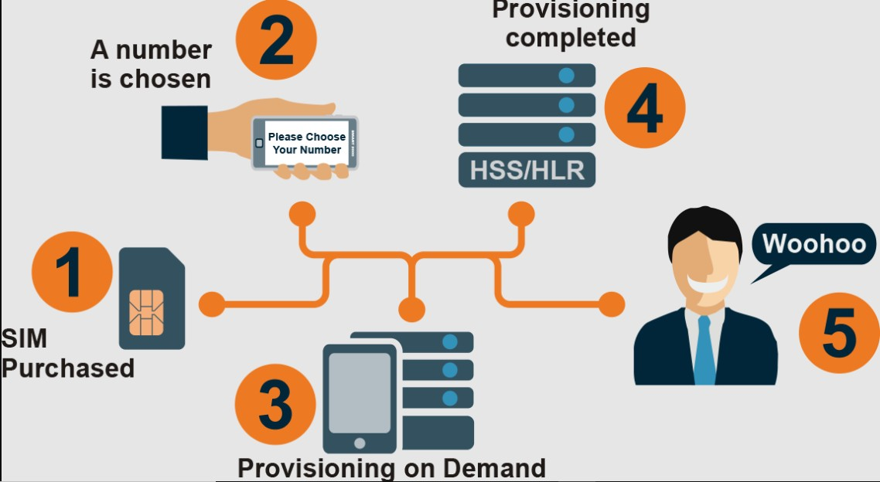
On-demand Provisioning
Fig13: Example of On-demand Provisioning
Jaya Nidhi Vashishtha
ACSIOT0602
Unit1

Slide 48
Recap
Elasticity in Cloud – On-demand Provisioning
Jaya Nidhi Vashishtha
ACSIOT0602
Unit1

Slide 49
Daily quiz
1. What does elasticity in cloud computing refer to? a) The ability of a system to adapt to increased or reduced demand automatically b) The physical flexibility of hardware devices c) The manual resizing of resources to match usage requirements d) The reduction of computational speed during high loads
Answer: a) The ability of a system to adapt to increased or reduced demand automatically
2. Why is elasticity important in cloud computing? a) It helps minimize operational costs by dynamically allocating resources as needed. b) It ensures that a single machine always handles all computations. c) It eliminates the need for virtualization. d) It restricts resource allocation during peak times.
Answer: a) It helps minimize operational costs by dynamically allocating resources as needed.
3. What does "on-demand provisioning" in cloud computing mean? a) Allocating physical hardware before it is required b) Providing computing resources dynamically based on user requests c) Pre-purchasing resources to handle future demand d) Manually configuring resources ahead of time
Answer: b) Providing computing resources dynamically based on user requests
4. Which of the following is a primary benefit of on-demand provisioning? a) Eliminates the need for virtualization b) Guarantees maximum resource usage at all times c) Reduces costs by allocating resources only when required d) Ensures fixed resources are allocated to all users
Answer: c) Reduces costs by allocating resources only when required
Jaya Nidhi Vashishtha
ACSIOT0602
Unit1

Slide 50

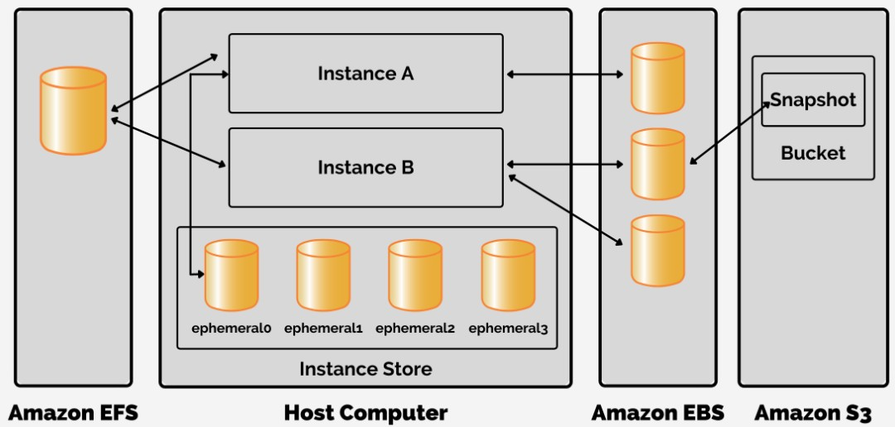
EC2 Instances and its types
EC2 stands for Elastic Compute Cloud. EC2 is on-demand computing service on the AWS cloud platform.
Under computing, it includes all the services a computing device can offer to you along with the flexibility of a virtual environment.
It also allows the user to configure their instances as per their requirements i.e. allocate the RAM, ROM, and storage according to the need of the current task.
EC2 provides you to rent virtual computers. The provision of servers on AWS Cloud is one of the easiest way in EC2 .
EC2 has resizable capacity. EC2 offers security, reliability, high- performance and cost-effective infrastructure so as to meet the demanding business needs.
Fig14: Amazon EC2
Jaya Nidhi Vashishtha
ACSIOT0602
Unit1
41

Slide 51
EC2 Instances and its types
Features of Amazon EC2:
Functionality –
EC2 provides its users a true virtual computing platform, where they can use various operations and even launch another EC2 instance from this virtually created environment.
This will increase the security of the virtual devices.
Not only creating but also EC2 allows us to customize our environment as per our requirements, at any point of time during the life span of the virtual machine.
Operating Systems –
Amazon EC2 includes a wide range of operating systems to choose from while selecting your AMI.
Not only these selected options, but users are also even given the privileges to upload their own operating systems and opt for that while selecting AMI during launching an EC2 instance.
Currently, AWS has the following most preferred set of operating systems available on the EC2 console.
Jaya Nidhi Vashishtha
ACSIOT0602
Unit1

Slide 52
EC2 Instances and its types
Software –
Amazon is single-handedly ruling the cloud computing market, because of the variety of options available on EC2 for its users.
It allows its users to choose from various software present to run on their EC2 machines.
This whole service is allocated to AWS Marketplace on the AWS platform. Numerous software like SAP, LAMP and Drupal, etc are available on AWS to use.
Scalability and Reliability –
EC2 provides us the facility to scale up or scale down as per the needs.
All dynamic scenarios can be easily tackled by EC2 with the help of this feature.
And because of the flexibility of volumes and snapshots, it is highly reliable for its users.
Due to the scalable nature of the machine, many organizations like Flipkart, Amazon rely on these days
whenever humongous traffic occurs on their portals.
Jaya Nidhi Vashishtha
ACSIOT0602
Unit1

Slide 53
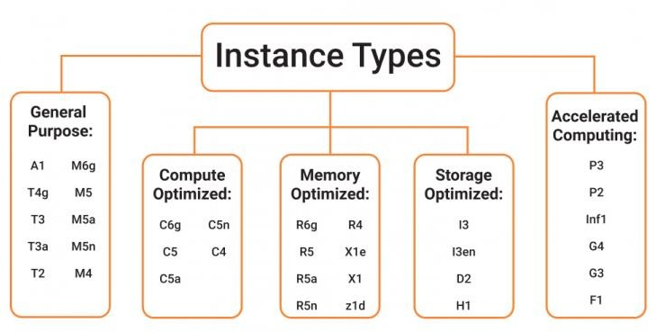
EC2 Instances and its types
Different Amazon EC2 instance types are designed for certain activities. Consider the unique requirements of your workloads and applications when choosing an instance type. This might include needs for computing, memory, or storage.
The types of Amazon EC2 Instances
are: (Fig 15)
Fig15: Instance Types
Jaya Nidhi Vashishtha
ACSIOT0602
Unit1

Slide 54
EC2 Instances and its types
Memory-Optimized Instances:
Memory-optimized instances are geared for workloads that need huge datasets to be processed in memory. Memory here defines RAM which allows us to do multiple tasks at a time. It stores all of the data and instructions that a central processing unit (CPU) needs to perform tasks.
A computer program or application must be loaded from storage into memory before it can run. This process of preloading gives the CPU direct access to the computer program.
Examples:
If your application uses a relational or non-relational database and needs to handle data quickly.
Processes that do not need a big quantity of data yet require speedy and real-time processing.
Jaya Nidhi Vashishtha
ACSIOT0602
Unit1
45

Slide 55
EC2 Instances and its types
2) Compute-Optimized Instances:
Compute-optimized instances are appropriate for applications that require a lot of computation and help from high- performance CPUs. You may employ compute-optimized instances for workloads including web, application, and gaming servers just like general purpose instances.
Compute-optimized programs, on the other hand, are best suited for high-performance web servers, compute-intensive application servers, and dedicated gaming servers. Compute-optimized instances can also be used for batch processing workloads that require processing several transactions in a single group.
Examples:
Applications that require high server performance or that employ a machine learning model will benefit from compute- optimized instances.
If you have some batch processing workloads or high-performance computing.
Jaya Nidhi Vashishtha
ACSIOT0602
Unit1
46

Slide 56
EC2 Instances and its types
3) General-Purpose Instances:
The computation, memory, and networking resources in general-purpose instances are balanced. Scenarios,
where you can use General Purpose Instances, are gaming servers, small databases, personal projects, etc.
Assume you have an application with a kind of equal computing, memory, and networking resource requirements. Because the program does not require optimization in any particular resource area, you can use a general-purpose instance to execute it.
Examples:
The applications that require computing, storage, networking, server performance, or want something from everything, can utilize general-purpose instances.
If high-performance CPUs are not required for your applications, you can go for general purpose instances.
Jaya Nidhi Vashishtha
ACSIOT0602
Unit1

Slide 57
EC2 Instances and its types
4) Storage Optimized Instances:
Storage optimized instances are made for workloads that demand fast, sequential read and write access to huge datasets. Distributed file systems, data warehousing applications, and high-frequency online transaction processing (OLTP) systems are examples of workloads that are suited for storage-optimized instances. Storage optimized instances are built to provide applications with the lowest latency while accessing the data.
Examples:
The applications which high processing of databases, can utilize storage optimized instances.
Data Warehousing applications or distributed file systems can use it.
Jaya Nidhi Vashishtha
ACSIOT0602
Unit1

Slide 58
4) Accelerated Computing Instances:
EC2 Instances and its types
Coprocessors are used in accelerated computing instances to execute specific operations more effectively than software running on CPUs. Floating-point numeric computations, graphics processing, and data pattern matching are examples of these functions.
A Hardware-Accelerator/ Co-processor is a component in computing that may speed up data processing. Graphics applications, game streaming, and
application streaming are all good candidates for instances.
Examples:
If the application utilizes floating-point calculations or graphics processing, accelerated computing instances will be the best amongst all.
Also, data pattern matching can be done more efficiently with this instance type.
accelerated computing
Jaya Nidhi Vashishtha
ACSIOT0602
Unit1
49

Slide 59
Recap
EC2 Instances and its types
Jaya Nidhi Vashishtha
ACSIOT0602
Unit1
49

Slide 60
Daily Quiz
1. What does EC2 stand for in Amazon Web Services (AWS)? a) Elastic Compute Cloud b) Electronic Computing Core c) Enhanced Cloud Configuration d) Enterprise Cloud Computing
Answer: a) Elastic Compute Cloud
4. Which of the following EC2 instance types is the most cost-effective for temporary workloads with flexible start and end times? a) On-Demand Instances b) Reserved Instances c) Spot Instances d) Dedicated Hosts
Answer: c) Spot Instances
2. What is an EC2 instance in AWS? a) A virtual server used to run applications on the cloud b) A storage service for data backup c) A physical hardware server dedicated to one user d) A database management tool in AWS
Answer: a) A virtual server used to run applications on the cloud
5. What is the primary purpose of EC2 Dedicated Hosts? a) To allow exclusive use of a physical server for meeting compliance requirements b) To automatically share resources among multiple users c) To reduce costs for temporary workloads d) To provide default instances for general-purpose applications
Answer: a) To allow exclusive use of a physical server for meeting compliance requirements
3. Which EC2 instance family is optimized for compute-intensive tasks such as scientific modeling or big data analysis? a) General-purpose instances b) Memory-optimized instances c) Compute-optimized instances d) Storage-optimized instances
Answer: c) Compute-optimized instances
6. Which type of EC2 instance is best suited for applications with steady and predictable workloads? a) Spot Instances b) Reserved Instances c) On-Demand Instances d) Dedicated Instances
Answer: b) Reserved Instances
Jaya Nidhi Vashishtha
ACSIOT0602
Unit1
49

Slide 61

Overview of different cloud service providers
A cloud service provider is a third-party company offering a cloud-based platform, infrastructure, application, or storage services. Much like a homeowner would pay for a utility such as electricity or gas, companies typically have to pay only for the amount of cloud services they use, as business demands require.
There are the following three types of cloud service models -
Infrastructure as a Service (IaaS)
Platform as a Service (PaaS)
Software as a Service (SaaS)
Jaya Nidhi Vashishtha
ACSIOT0602
Unit1

Slide 62
Overview of different cloud service providers
EC2 Instances and its types
Infrastructure as a Service (IaaS)
IaaS is also known as Hardware as a Service (HaaS). It is a computing infrastructure managed over the internet. The main advantage of using IaaS is that it helps users to avoid the cost and complexity of purchasing and managing the physical servers.
Characteristics of IaaS
There are the following characteristics of IaaS -
Resources are available as a service
Services are highly scalable
Dynamic and flexible
GUI and API-based access
Automated administrative tasks
Example: DigitalOcean, Linode, Amazon Web Services (AWS), Microsoft Azure, Google
Compute Engine (GCE), Rackspace, and Cisco Metacloud.
Jaya Nidhi Vashishtha
ACSIOT0602
Unit1

Slide 63

Overview of different cloud service providers
2) Platform as a Service (PaaS)
PaaS cloud computing platform is created for the programmer to develop, test, run, and manage the applications.
Characteristics of PaaS
There are the following characteristics of PaaS -
Accessible to various users via the same development application.
Integrates with web services and databases.
Builds on virtualization technology, so resources can easily be scaled up or down as per the
organization's need.
Support multiple languages and frameworks.
Provides an ability to "Auto-scale".
Example: AWS Elastic Beanstalk, Windows Azure, Heroku, Force.com, Google App Engine,
Apache Stratos, Magento Commerce Cloud, and OpenShift.
Jaya Nidhi Vashishtha
ACSIOT0602
Unit1

Slide 64
Overview of different cloud service providers
3) Software as a Service (SaaS)
SaaS is also known as "on-demand software". It is a software in which the applications are hosted by a cloud service provider. Users can access these applications with the help of internet connection and web browser.
Characteristics of SaaS
There are the following characteristics of SaaS -
Managed from a central location
Hosted on a remote server
Accessible over the internet
Users are not responsible for hardware and software updates. Updates are applied automatically.
The services are purchased on the pay-as-per-use basis
Example: BigCommerce, Google Apps, Salesforce, Dropbox, ZenDesk, Cisco WebEx, ZenDesk,
Slack, and GoToMeeting.
Unit1
53

Slide 65

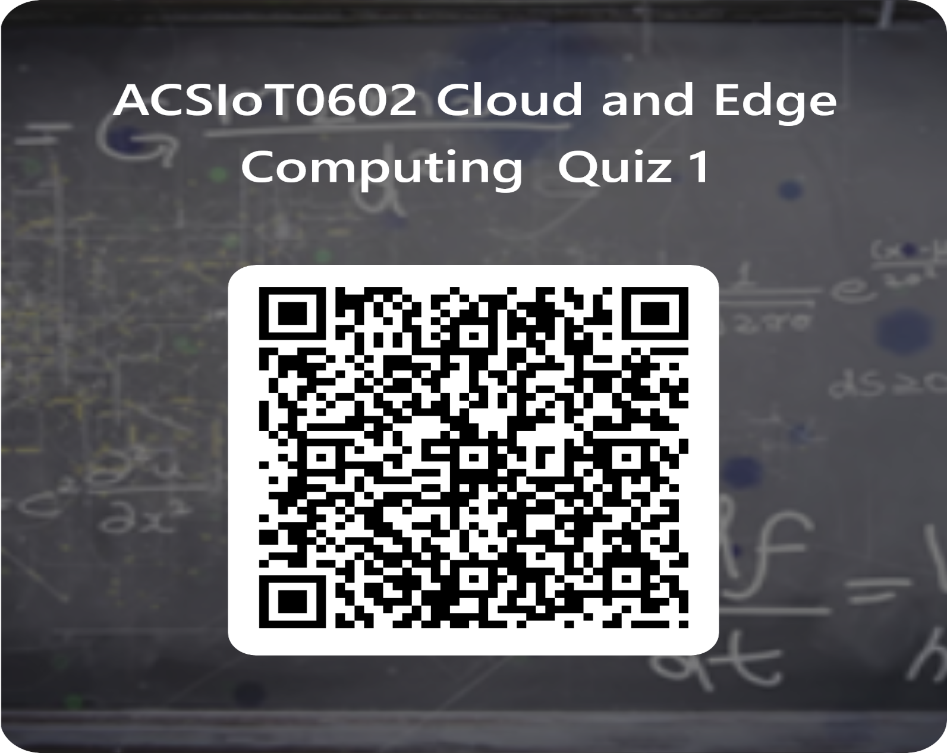
Daily Quiz
Jaya Nidhi Vashishtha
ACSIOT0602
Unit1

Slide 66
Daily Quiz
What is Cloud Computing?
Cloud Computing means providing services like storage, servers, database, networking, etc
Cloud Computing means storing data in a database
Cloud Computing is a tool used to create an application
None of the mentioned
Who is the father of cloud computing?
Sharon B. Codd
Edgar Frank Codd
J.C.R. Licklider
Charles Bachman
3) Which of the following are the features of cloud computing?
Security
Availability
Large Network Access
d)
All of the mentioned
Jaya Nidhi Vashishtha
ACSIOT0602
Unit1

Slide 67
Daily Quiz
Which of the following is a type of cloud computing service?
Service-as-a-Software (SaaS)
Software-and-a-Server (SaaS)
Software-as-a-Service (SaaS)
Software-as-a-Server (SaaS)
Which of the following is the application of cloud computing?
Adobe
Paypal
Google G Suite
All of the above
3) Which of the following is an example of the cloud?
Amazon Web Services (AWS)
Dropbox
Cisco WebEx
d)
All of the mentioned
Jaya Nidhi Vashishtha
ACSIOT0602
Unit1

Slide 68

MCQs
Applications and services that run on a distributed network using virtualized resources is known as
Parallel computing
Soft computing
Distributed computing
Cloud computing
Which of the following is an example of a PaaS cloud service?
Heroku
AWS Elastic Beanstalk
Windows Azure
All of the above
Which of the following is an example of an IaaS Cloud service?
DigitalOcean
Linode
Rackspace
All of the mentioned
Jaya Nidhi Vashishtha
ACSIOT0602
Unit1
56

Slide 69
MCQs
Which of the following is the correct statement about cloud computing?
Cloud computing abstracts systems by pooling and sharing resources
Cloud computing is nothing more than the Internet
The use of the word “cloud” makes reference to the two essential concepts
All of the mentioned
Point out the wrong statement.
Azure enables .NET Framework applications to run over the Internet
Cloud Computing has two distinct sets of models
Amazon has built a worldwide network of datacenters to service its search engine
None of the mentioned
Which of the following is the correct statement?
Cloud computing presents new opportunities to users and developers
Service Level Agreements (SLAs) is small aspect of cloud computing
Cloud computing does not have impact on software licensing
All of the mentioned
Jaya Nidhi Vashishtha ACSIOT0602 Unit1
57

Slide 70
Previous Year Question Paper
2022-23
2023-24

Slide 71
Expected University Questions
Define cloud. And what is Cloud Computing?
What is on-demand functionality? How is it provided in cloud computing?
What are the advantages of cloud services?
What are the basic clouds in cloud computing? What are some of the popularly used cloud computing services?
Explain briefly evolution of cloud computing.
Write down briefly about Parallel Computing.
Write down briefly about Distributed Computing.
Illustrate the principles of Parallel and Distributed Computing.
Conclude cloud characteristics.
Jaya Nidhi Vashishtha
ACSIOT0602
Unit1

Slide 72

Weekly assignment
What is Cloud Computing? Write advantages of cloud computing.
What are different types of cloud computing.
What do you mean by cloud services?
What is the need of cloud computing?
Write down the characteristics of cloud computing.
Define distributed computing.
Write down the advantages of parallel computing.
Name some companies that provide cloud service.
Jaya Nidhi Vashishtha
ACSIOT0602
Unit1

Slide 73

Summary
This Unit consist of all the benefits of cloud and edge computing are-
Introduction to Cloud Computing
Evolution of Cloud Computing
Underlying Principles of Parallel and Distributed Computing
Elasticity in Cloud and On-demand Provisioning,
EC2 Instances and its types.
Overview of different cloud service providers
Jaya Nidhi Vashishtha
ACSIOT0602
Unit1

Slide 74

Reference
https://en.wikipedia.org/wiki/Cloud_computing
https://www.javatpoint.com/cloud-computing
https://www.javatpoint.com/cloud-service-models
https://www.javatpoint.com/cloud-service-provider-companies
https://www.javatpoint.com/what-is-parallel-computing
https://www.geeksforgeeks.org/introduction-to-parallel-computing/
https://www.geeksforgeeks.org/evolution-of-cloud-computing/
https://www.slideshare.net/joyschandran/underlying-principles-of-parallel-and-distributed-computing
https://www.techslang.com/definition/what-is-cloud- provisioning/#:~:text=Also%20referred%20to%20as%20%E2%80%9Con,and%20down%20when%20de mands%20decrease.
Jaya Nidhi Vashishtha
ACSIOT0602
Unit1
61

Slide 75


Jaya Nidhi Vashishtha
ACSIOT0602
Unit1
62

